Slide 1
LSI Design Contest 2018 Neural Network (Backpropagation)
Huy-Hung Ho, Van-Thuat Nguyen,
Xuan-Thuan Nguyen, Van-Dung Nguyen
Key Laboratory for Smart Integrated Systems (SISLAB)

Slide 2
Outline
Introduction LSI Contest
Artificial neural network
Backpropagation algorithm
Conclusion

Slide 3
Introduction LSI Contest
Challenge: "Neural Network(Backpropagation)“
Deadline: 31st Jan, 2018

Slide 4
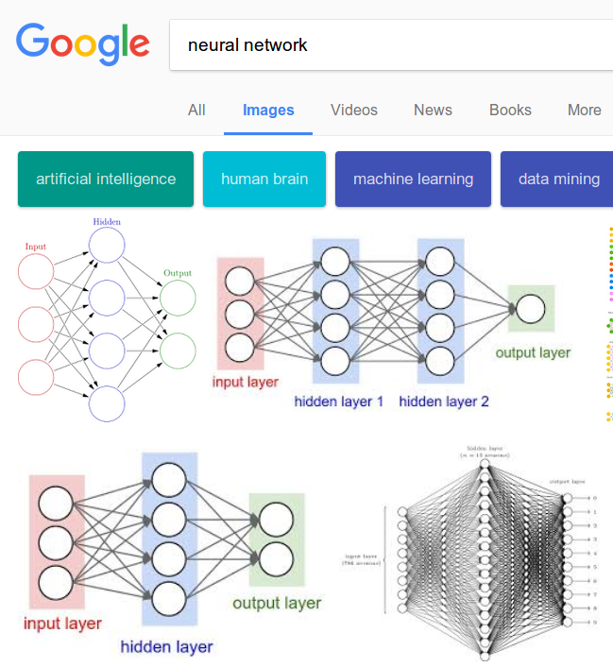
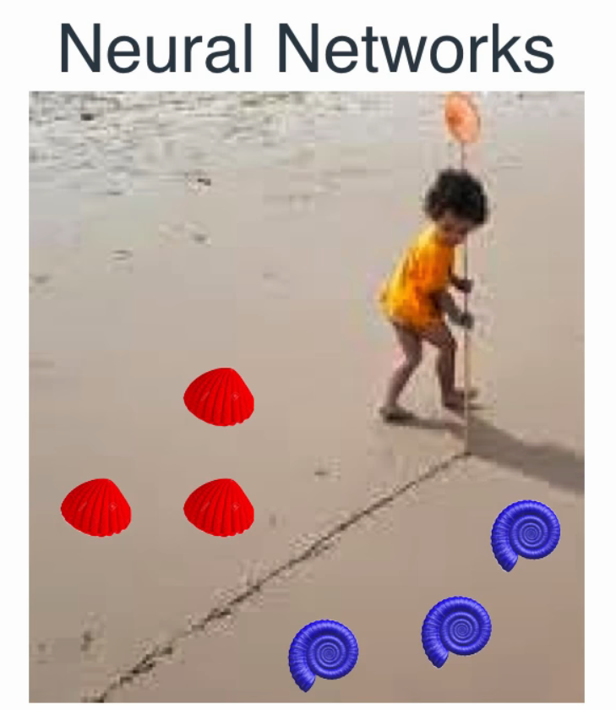
Artificial neural network

Slide 5
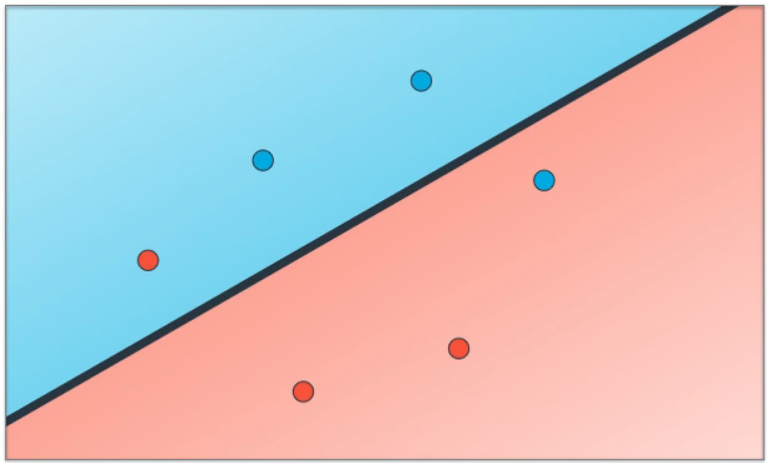
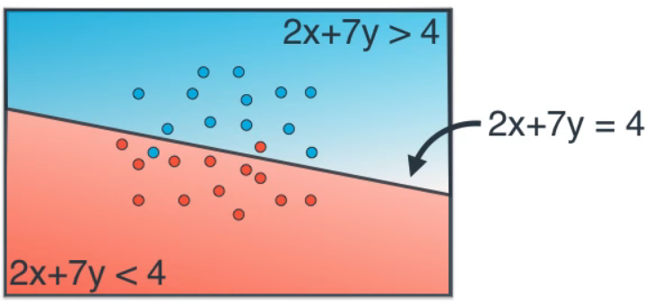

Neuron (perceptron)
x
($x_{1}, y_{1}$)
y
x
2
4
2x + 7y - 4
y
7

Slide 6
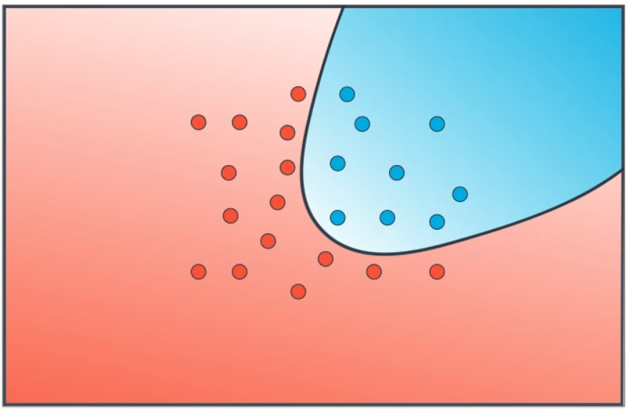
Non-linear regions
?

Slide 7
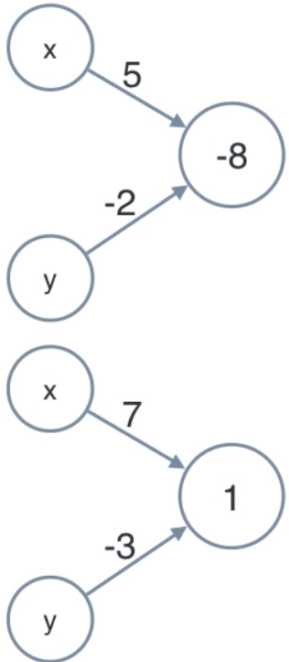
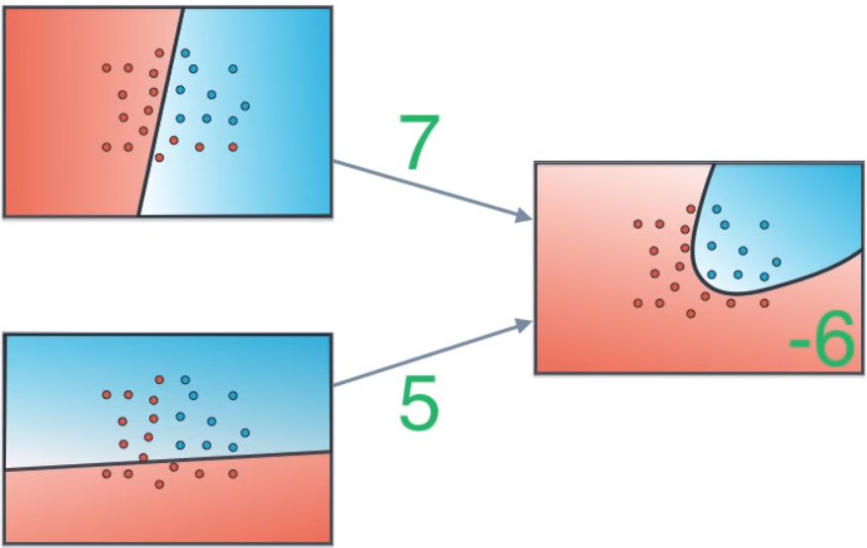
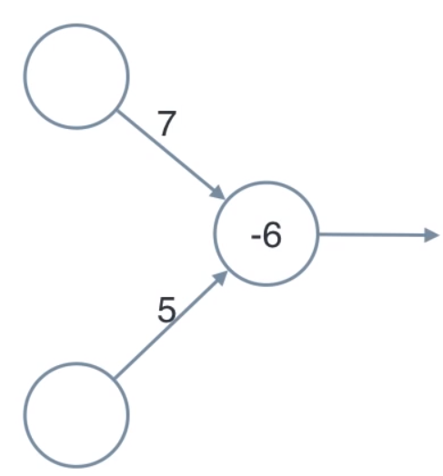
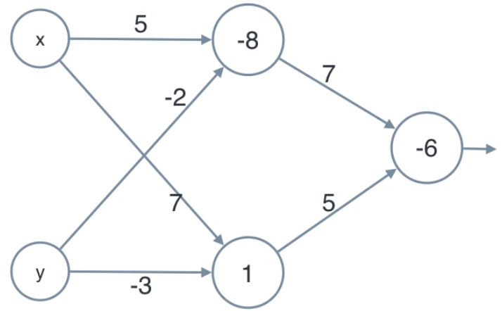
Combining Regions

Slide 8
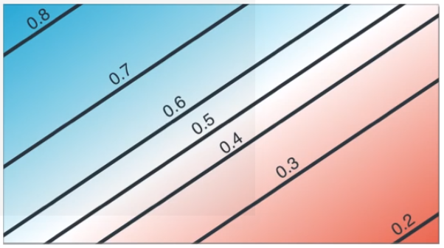
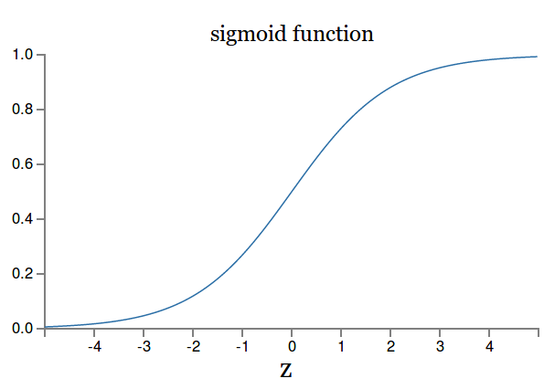
Logistic Regression
x
2
4
y
7
x
2
4
F(.)
y
7
Activation funcion
Small changes in the weights and biases to achieve any desired small change in the output => for learning

Slide 9
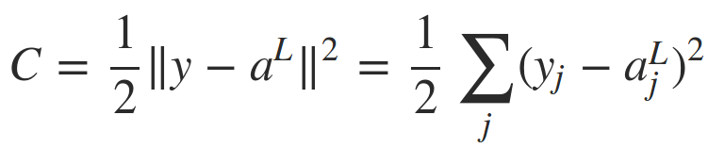


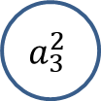
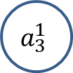



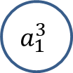

Return the math matrix
Input layer (1)
Hidden layer (2)
Ouput layer (3)
$$b_{1}^{3}$$
$$a_{3}^{1}$$
$$w_{ 1}^{3}$$
$$a_{1}^{3}$$
$$a_{1}^{L}$$
$$a_{3}^{2}$$
$$Cost =C(a^{L})$$
$$a_{2}^{L}$$
Activation output:
Square error:

Slide 10

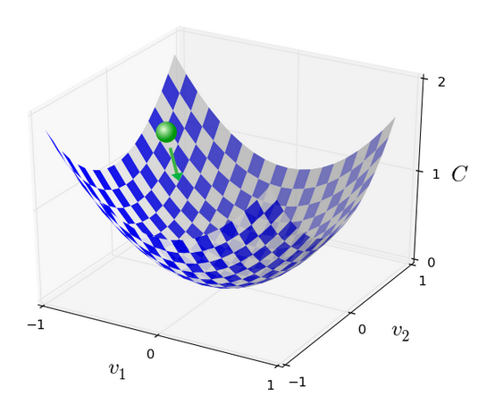
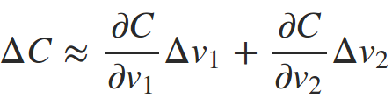
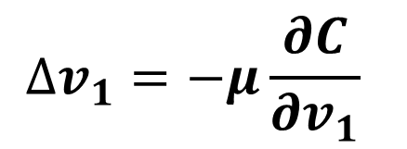
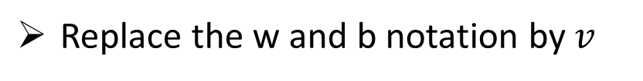
Gradient Decent
Cost Function (mean squared error – MSE)
Replace the w and b notation by $v$
$$∆v_{1}=−μ\frac{∂C}{∂v_{1}}$$
Gradient Decent

Slide 11
Outline
Introduction LSI Contest
Artificial neural network
Backpropagation algorithm
Conclusion

Slide 12


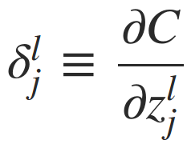




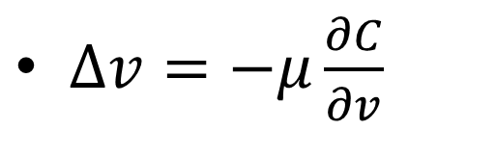
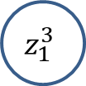



Backpropagation algorithm
$∆v=−μ\frac{∂C}{∂v}$
How quickly the cost change when we change the weights and biases
Weighted input:
$$b_{1}^{3}$$
$$w_{ 1}^{3}$$
$$z_{1}^{3}$$
$$a_{1}^{3}$$
$$a_{2}^{2}$$
Error of neuron:
$$δ_{}^{1}$$
$$δ_{}^{2}$$
$$δ^{L}$$

Slide 13


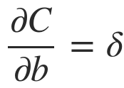
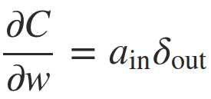

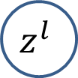

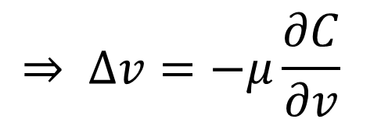


Backpropagation algorithm
$$δ_{}^{l}$$
$$z^{l}$$
$$δ^{L}$$
$$z^{L}$$
$$a_{}^{L}$$
$$⇒ ∆v=−μ\frac{∂C}{∂v}$$

Slide 14
Hardware implementation papers
Using LUT for activation function, DSP
Using PE direction, includes: control, pattern, architecture block
Using math algorithm direction

Slide 15
Discussion
Design direction:
area, energy, performance
PE or folow math
Memory?
Division jobs, global rules…
Available:
SW: C++ src
HW: Verilog from LSI contest
ANN is the matrix multipliers
ANN is the matrix multipliers (??)

Slide 16
The end

Slide 17
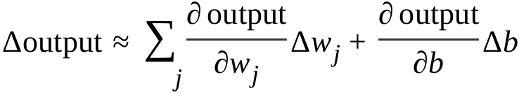
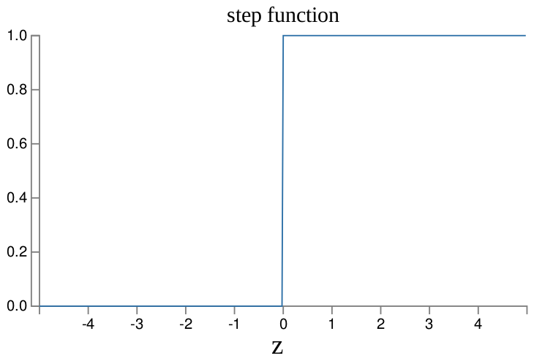
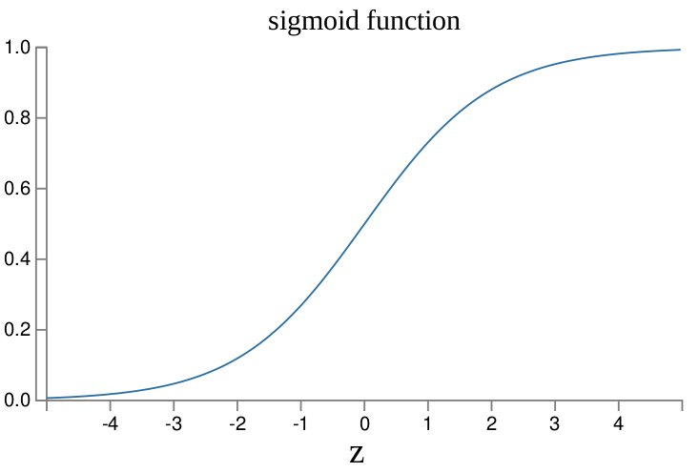
Why signmoid function?
Sigmoid function is easy to differentiate and easy to compute forward (derivative)
Smoothness (Δoutput is a linear function of the changes Δw j and Δb in the weights and bias):

